Slide 1





Youth Engagement and ICTs in Asia: A Comparative Approach
THE POLITICS AND ECONOMICS OF MEDIA CONVERGENCE
The Joint Summer School by CUC, CUHK, Westminster and UPenn
Weiyu Zhang (PhD, UPenn), Assistant Professor
Communications and New Media, National Univ. of Singapore

Slide 2
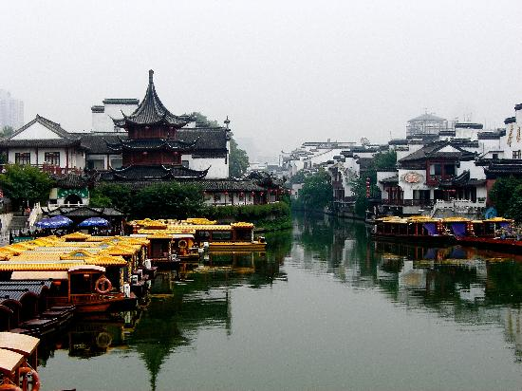

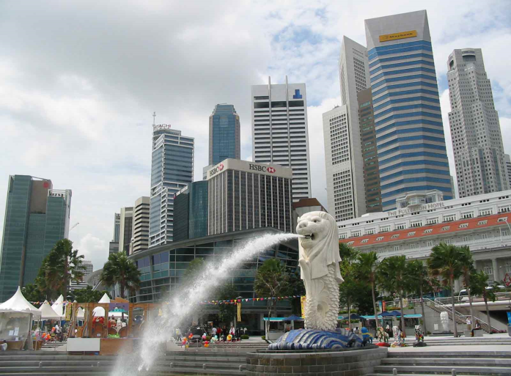
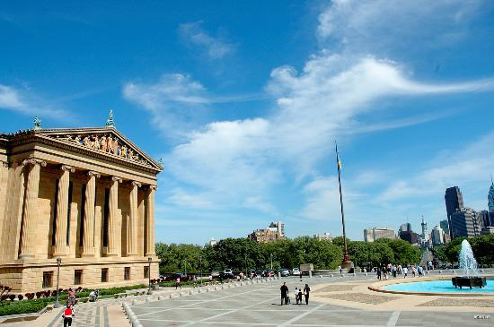
Who am I?

Slide 3
Contents
1
Comparative study
2
Youth and ICTs
3
Singapore
4
India
5
China
6
Panel Discussion

Slide 4
Science is “unavoidably comparative” (Lasswell, 1968)

Slide 5
Comparative Analysis
Four models (Livingstone, 2003)
what is unique about each case
tests the hypothesized generality of findings across cases
systematic relations are sought, each case thereby serving as one unit or data point
compares cases insofar as they are systematically interrelated due to some underlying processes

Slide 6
Comparative Analysis
Difficulties with the approach
Different yet comparable
the many variables problem

Slide 7
Youth and ICTs

Slide 8

Why Youth?
Youth as a pivotal group
Youth as a problematic group
The ’80ers and the ’90ers
Youth and risky behaviors
Notes:
no direct experience of Maoist socialism, a vague memory of 1989, a direct experience with economic reform and economic development which is taken for granted, singletons or having fewer siblings due to the one-child policy, and a flourish of information due to the reform of mass media and the emergence of new media

Slide 9




Why ICTs?
Rapid growth of new media penetration
Innovative usage of new media
Social impacts of new media
Education
Workplace
Family
Consumers

Slide 10

Why youth and ICTs?
The Net Generation (Tapscott, 2009)
ICTs Make youth innovative, collaborative, and want more fun
ICTs Make youth dumb, shameless, narcissistic, and hate working

Slide 11
Research questions
RQ1: How do youth use ICTs to engage in social activities?
RQ2: How do ICTs change the relationship between youth and established institutions?
RQ3: How do ICTs change the nature of youth participation?

Slide 12
Methods
Policy studies
20-30 in-depth interviews
15-35 year old
Urban youth with full access to new media and have participated in some social activities
5-10 focus groups
15-35 year old
Average youth

Slide 13
Looking east to look west?

Slide 14
Comparability?
Singapore vs. China
Ethnic Chinese, authoritarian governance
Size, economic development, racial relationship
India vs. China
Size and economic development
Government system, language and culture

Slide 15
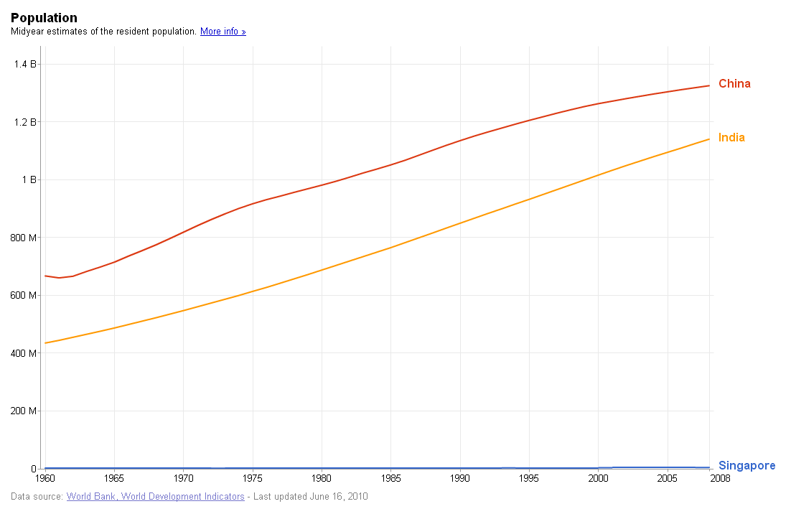
Population

Slide 16
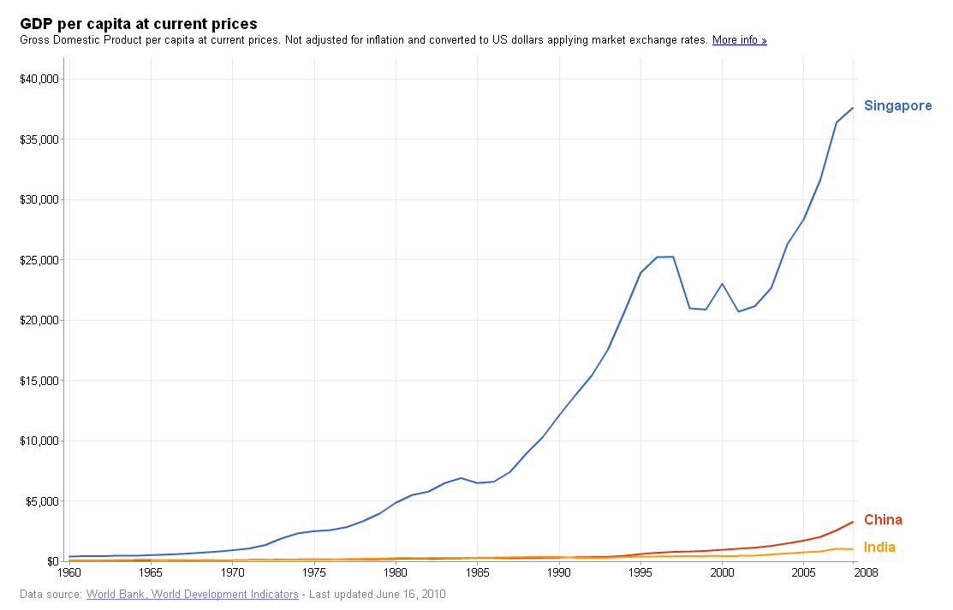
GDP per capita
Notes:
India: us $1016
China: 3266
Singapore: 37597

Slide 17
Singapore
21% youth (15-29 years old), 750 thousands
Literacy rate: 97%
Mobile phones: 138/100
Internet users: 66/100 (2005)

Slide 18





Policies
ICTs
Infrastructure
Content
Mass media policies
Youth
Schools
Government agencies
Political parties
NGOs and iNGOs

Slide 19
Interview findings
Internet as information sources
SNS as dissemination tool
Mobile phones mainly for interpersonal contact
Online multimedia content, Open source platforms to facilitate international collaboration
Knowledge-building
Choosing issues
International vision
Being alien to local issues
Institution-bypassing
Speakers’ corner

Slide 20

India
41% between 13 and 35 years old, 400 million
65% general literacy rate, 82% in Delhi
Mobile phones: 30%
Internet users: 7%

Slide 21


Policies
ICTs
Youth
National Youth Policy 2003
National Youth Corps as full time volunteers
National Youth Awards, exchange programme, funding for NGOs

Slide 22
Interview findings
TV and newspaper as major information sources
Mobiles are heavily used for almost all purposes
SNS and online chats better in information dissemination
Fill in the inadequacies
Social services focused
Self satisfaction and self fulfillment
I am no less than a star…more like a God!

Slide 23


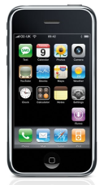
China
23% 14-29 years old
Literacy rate: 91%
Mobile phones: 51%
Internet users: 29%

Slide 24


Policies
ICTs
Youth
One-child policy
No governmental ministries specifying in youth
Education, employment, participation
Risky behaviors, poverty

Slide 25
What can we find in china?

Slide 26
Panel Discussion
Form 6 groups/Select a moderator
5 minutes
What ICTs are used by young people and how?
10 minutes
Do ICTs change young people’s life style?
10 minutes
Do ICTs change the relationship between young people and established institutions?
10 minutes
Present your results
5 minutes each group
Summarize your discussions
5 minutes

Slide 27
Thank You! 汐止小镇咖啡馆见！
cnmzw@nus.edu.sg
13521409308

